Slide 1
RadioDNS Hybrid Radio
From FM, to DAB, to IP

Slide 2
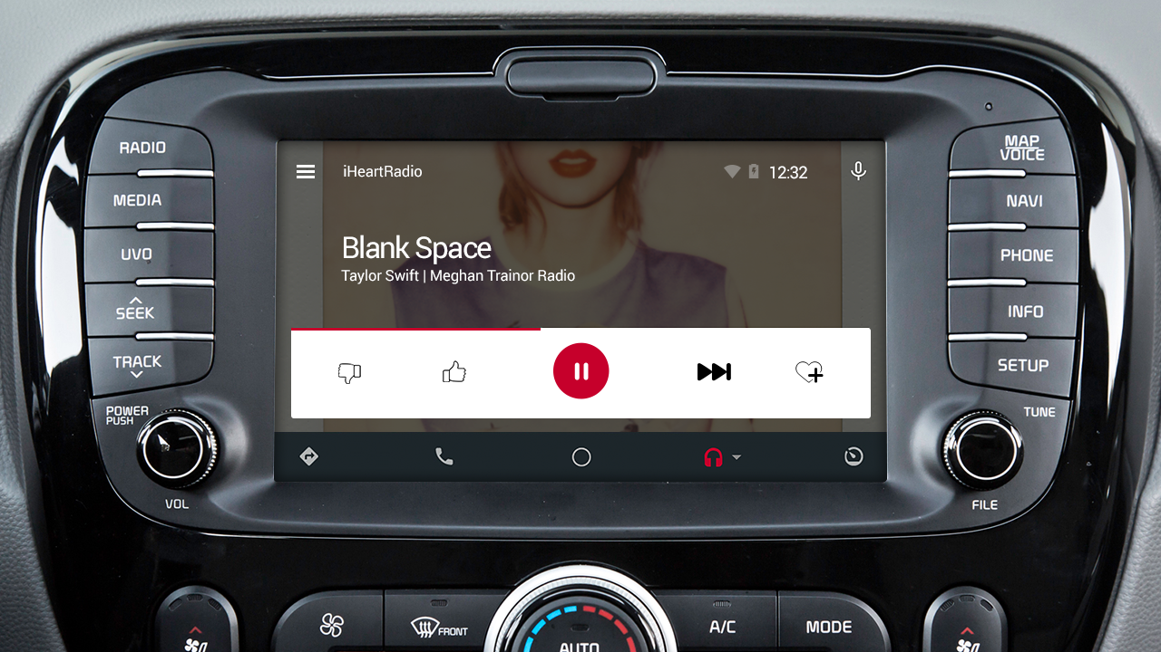
Why Hybrid?
Kate Tempest
Not Kate Tempest
Dashboard screen resolution 1280px x 720px
“Good” quality image 68kbytes (~550kbits)
FM RDS transmission time 5,958 seconds (.12kbit/s) *
DAB transmission time 89 seconds (8kbit/s) *
IP transmission time 0.55 seconds (1Mbit/s)
* Assumes average 1.3 repetitions to acquisition, using typically available data rates

Slide 3
Broadcast or Internet?

Slide 4
Broadcast and Internet!

Slide 5
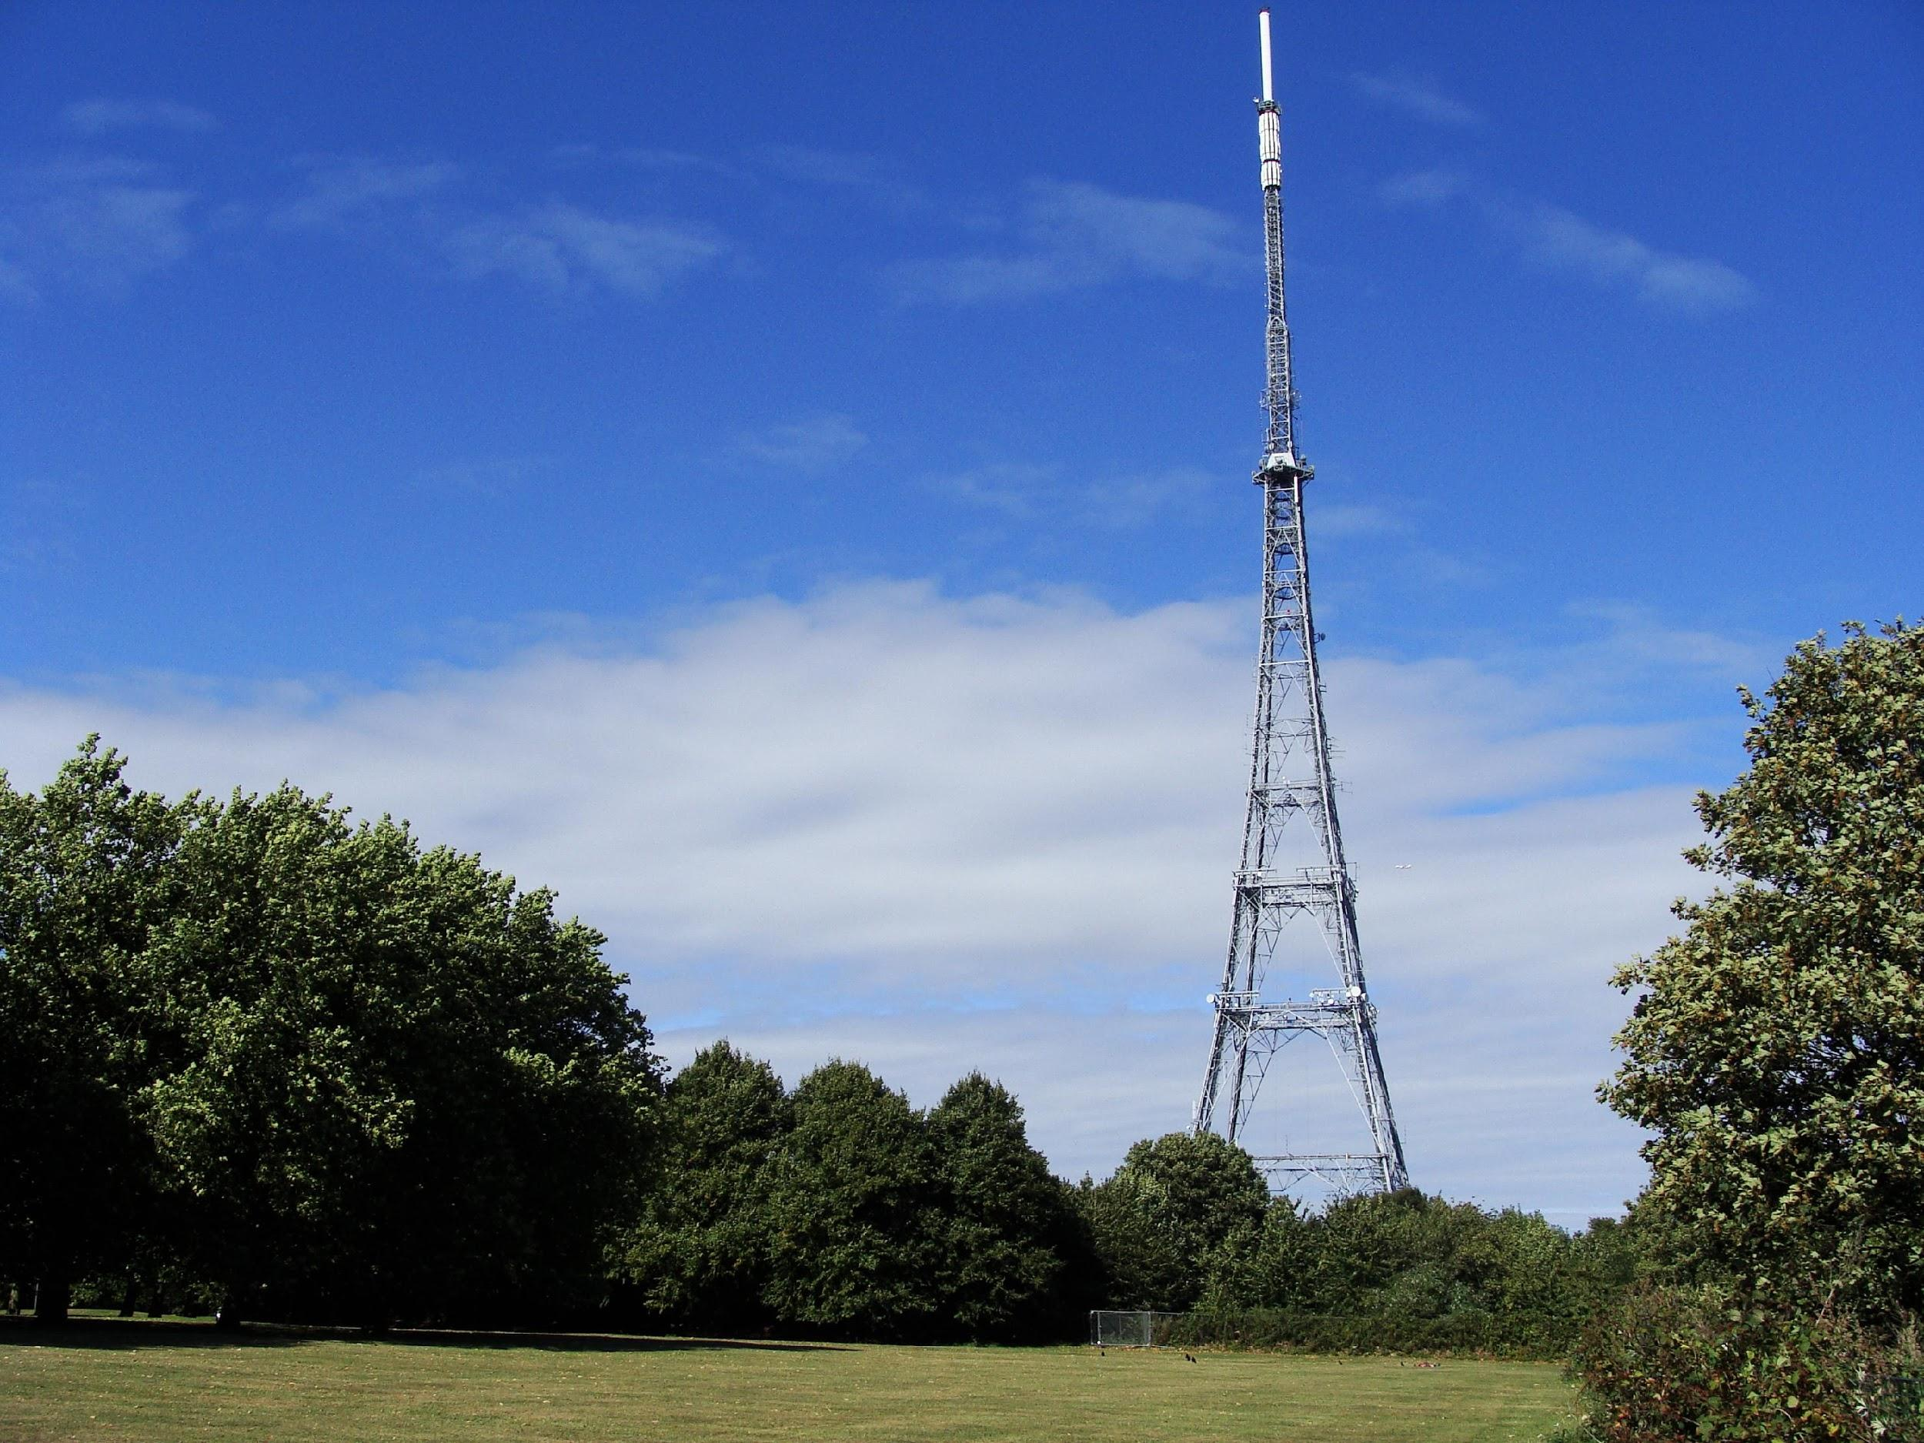
Weaknesses
Inflexible
Low functionality
Hard to measure
No customization
Cost to the user
Cost to the broadcaster
Net neutrality uncertainty
Variable reliability / coverage

Slide 6
Strengths
Free for the listener
Economic for broadcasters
Stable regulation
Reliable
Widespread coverage
Flexible
Interactive
Measurable
Customizable

Slide 7
Hybrid Radio
Deliver audio using broadcast
Reliable, ubiquitous, free, economic
Enhance radio using IP
Add a digital experience & interactivity

Slide 8
Why “RadioDNS”?
RadioDNS operates a specialist DNS server for radio
Helps the radio discover and connect to the radio station using IP
Capital FM (95.8MHz, RDS PI code C479) = capitalfm.com
KSNE (106.5MHz, RDS PI code A4DE) = iheartmedia.com

Slide 9
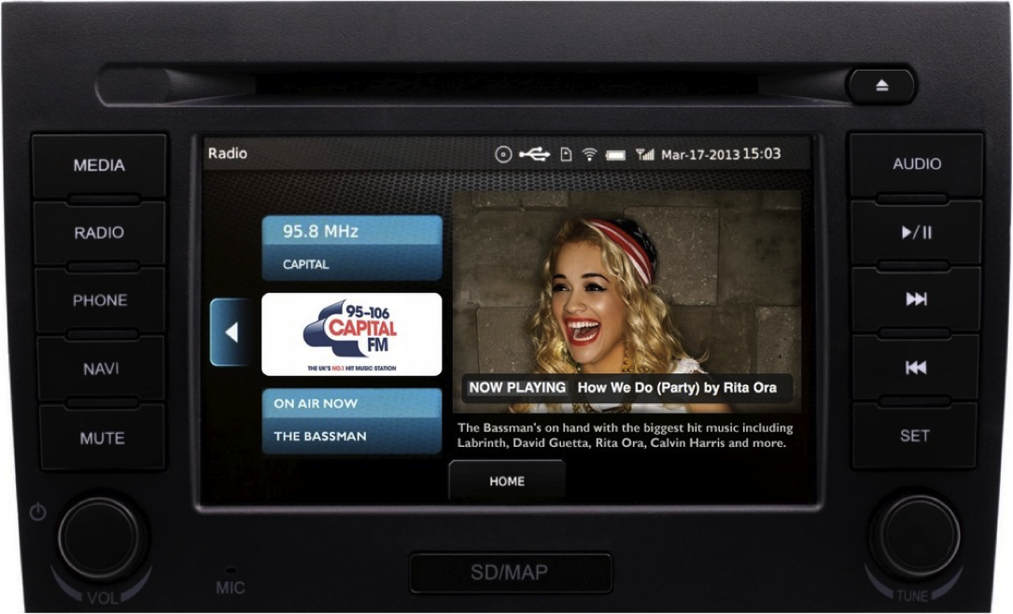
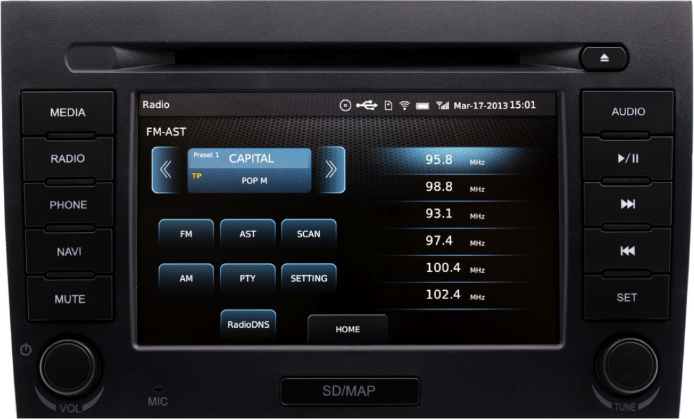
1. Existing Identifiers
(e.g. f=95.8MHz, PI=c479)
FM / DAB / HD Radio
4. Contact to‘capitalfm.com’
Exchange data over IP
IP
2. DNS lookup
‘09580.c479.ce1.fm.radiodns.org’
Capital FM
95.8MHz
capitalfm.com
3. DNS Response
‘capitalfm.com’
DNS

Slide 10
FM / DAB / HD Radio
IP
Capital FM
95.8MHz
capitalfm.com
Listener finds station by tuning normally
No central database of stations
The radio connects directly to radio station
NO connections come via RadioDNS

Slide 13
317,256 bytes in 0.03s

Slide 14
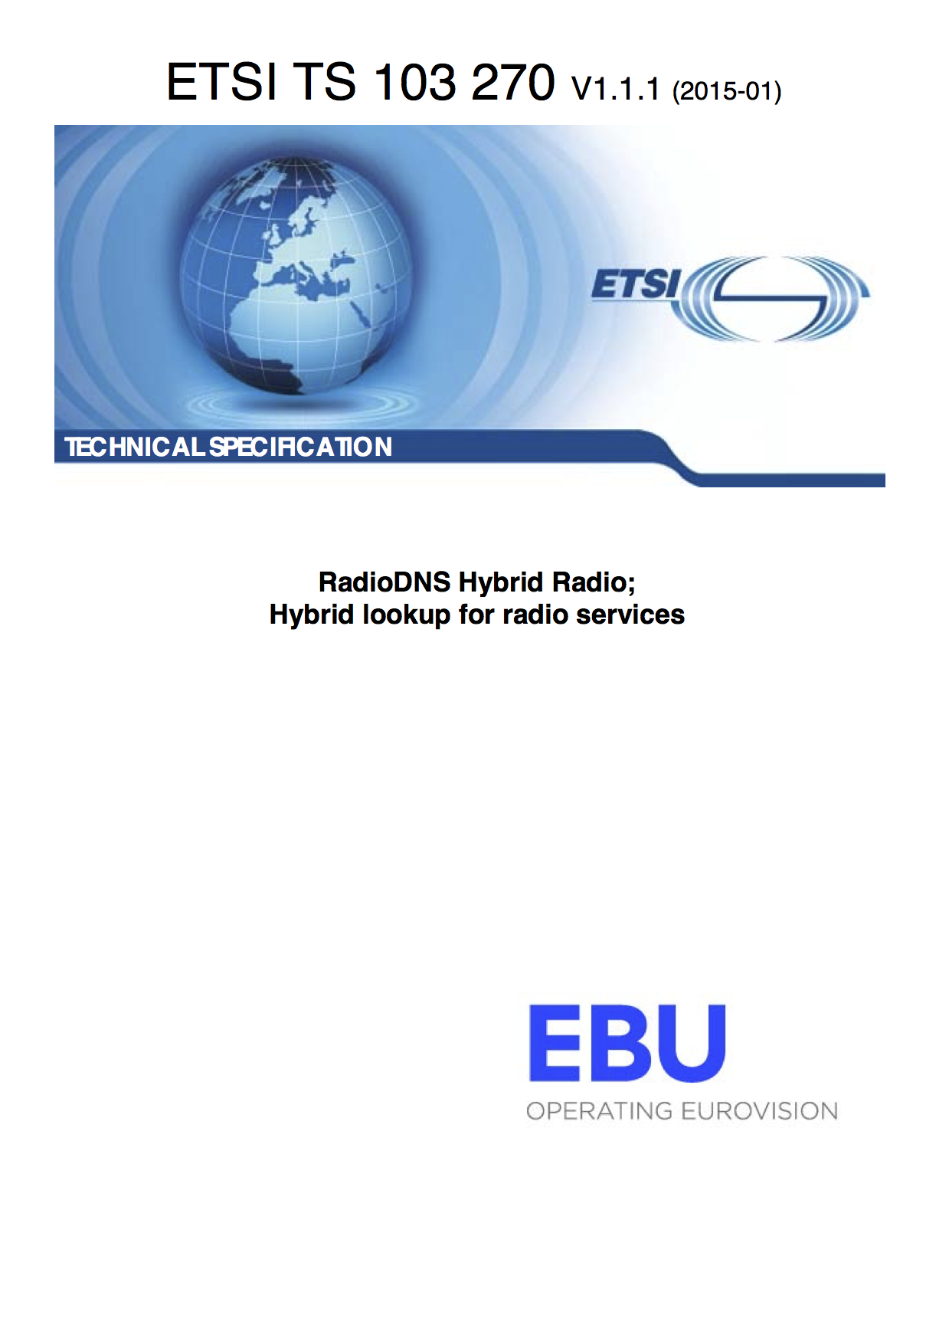
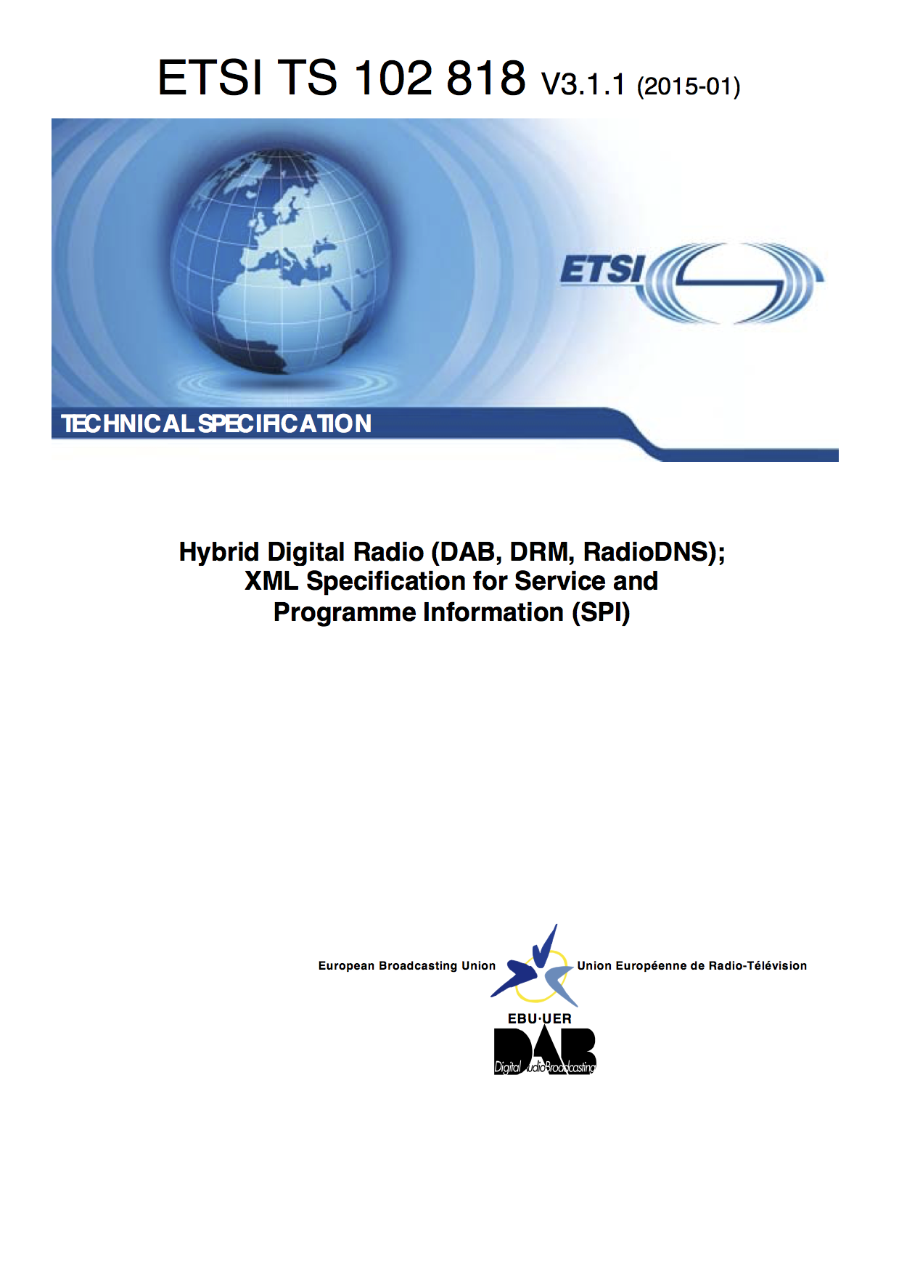
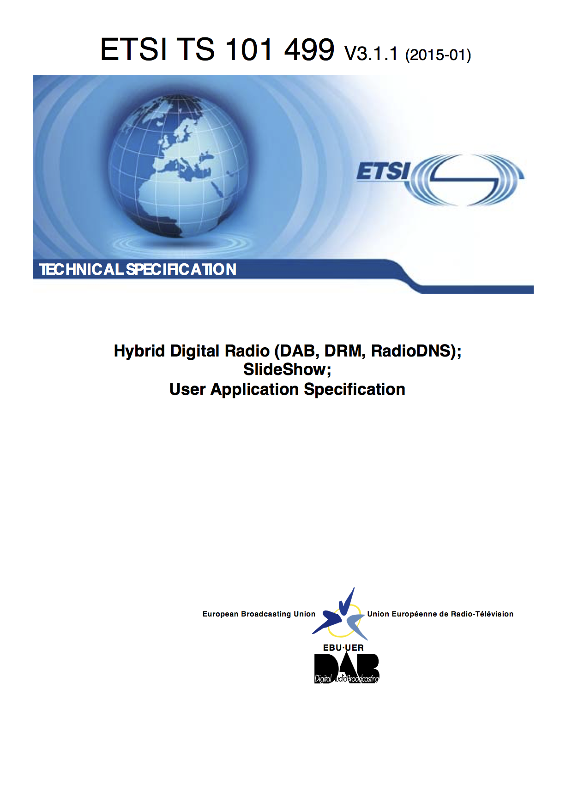

Slide 15
Hybrid Applications
SPI – Service and Programme Information
Names, logos, programme descriptions, phonemes, …
Visual Slideshow
Real-time images and text push service
RadioTAG
Save interesting things you hear on the radio to look at / listen to later

Slide 16
Implementing RadioDNS
Use free / open-source tools:
SPI HTTP, XML
Visuals HTTP, STOMP, JSON
RadioTAG HTTP, JSON, Oauth
Or you can buy a SaaS / Cloud solution from a service provider (e.g Aiir, 7Digital, Pluxbox, AIM)

Slide 17
RadioDNS Hybrid Radio
radiodns.org

